Slide 1
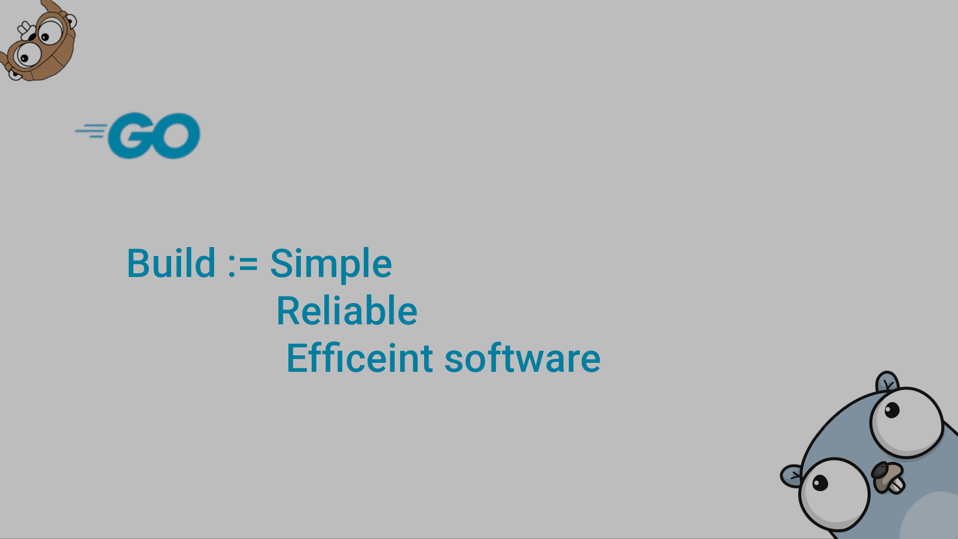
Go Fundamentals Part I

Slide 2
Compilers, Interpreters, and JIT
Feature | Compiler | Interpreter | JIT
Translation Time | Before execution | During execution | During execution
Output | Native executable | No separate file | Native code generated at runtime
Speed | Very fast | Slower | Fast (after warm-up)
Error Detection | After compilation | Line by line | Mixed
Example | C, C++, Go | Python, JS | Java, C#

Slide 3
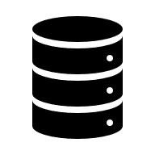
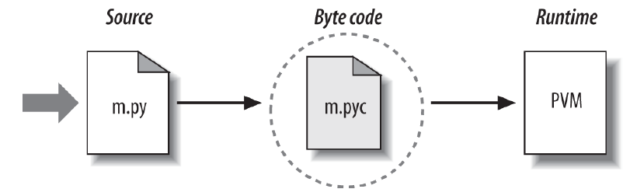
Compilers, Interpreters, and JIT
RAM
Editor (VS code)
Preprocessor
Compiler
Linker
Loader
CPU
main.c
Expanded source (temp)
main.obj
.lib (static library) = collection of .obj files grouped together Dynamic library = (.dll + .lib)
main.exe
A .dll (Dynamic Link Library) is a file that contains compiled code and resources that can be used by multiple programs at runtime.
Notes:
Preprocessing: expands #include, expands macros, and removes comments
Compiler: The compiler translates C/C++ into assembly, then machine code. Main.obj contains machine code, unresolved symbols, and relocation info; Functions from other files are NOT yet resolved.
Linker: links the object code with the libraries, creates an executable file, and stores it on disk.
=> Static linking: The linker extracts required object code then Copies it into the .exe
=> Dynamic linking: .dll Contains actual compiled machine code and loaded at run time
.lib Import library, Contains symbol information only and Used by the linker

Slide 4
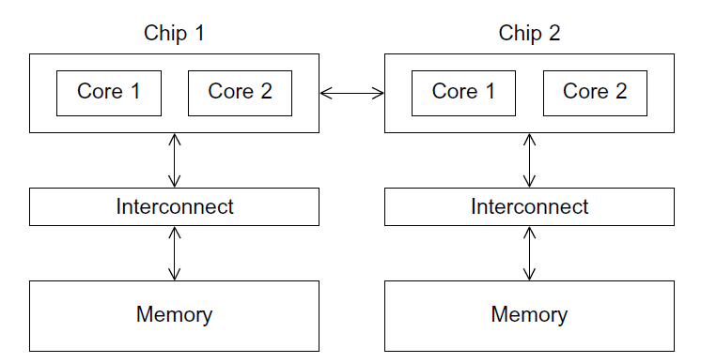
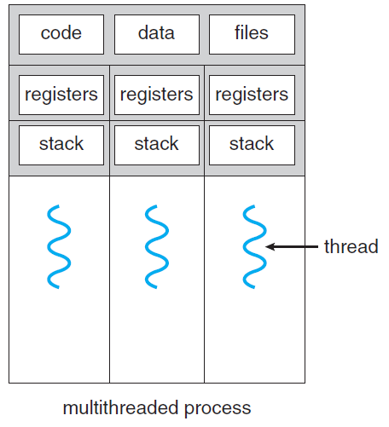
Processor Chip:
RAM
CPU
CPU
CPU
CPU
Loader
CPU
main.exe

Slide 5
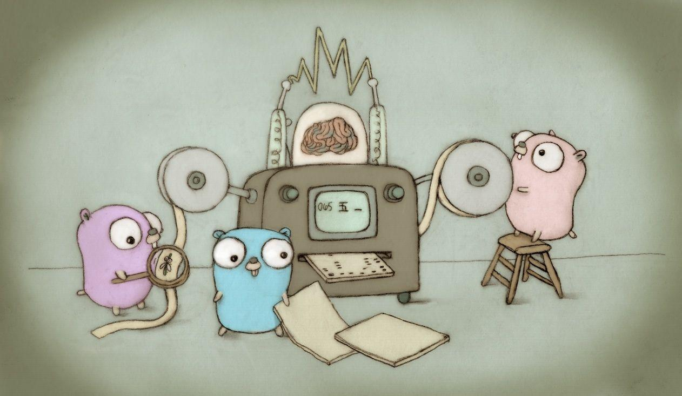

Slide 6
The Go lang:
Go is an open-source programming language that makes it easy to build simple, reliable,
and efficient software.
The goals of the language and its accompanying tools were to be expressive, efficient in both compilation and execution, and effective in writing reliable and robust programs.
It borrows and adapts good ideas from many other languages, while avoiding features that have led to complexity and unreliable code.
Its facilities for concurrency are new and efficient, and its approach to data abstraction and object-oriented programming is unusually flexible.
Go is especially well-suited for building infrastructure like network services, and tools and systems for programmers, but it is truly a general-purpose language and finds use in domains as diverse as graphics, mobile applications, and machine learning

Slide 7
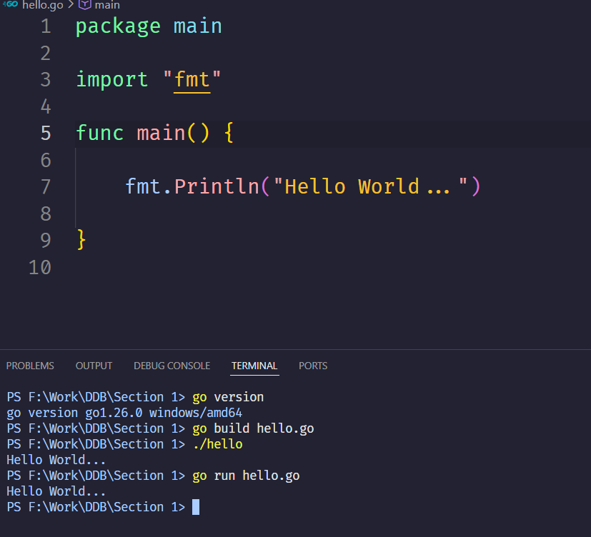
The Go Program Structure:
This is known as a package declaration, and every Go program must start with it. Now we have an executable file…

Slide 8
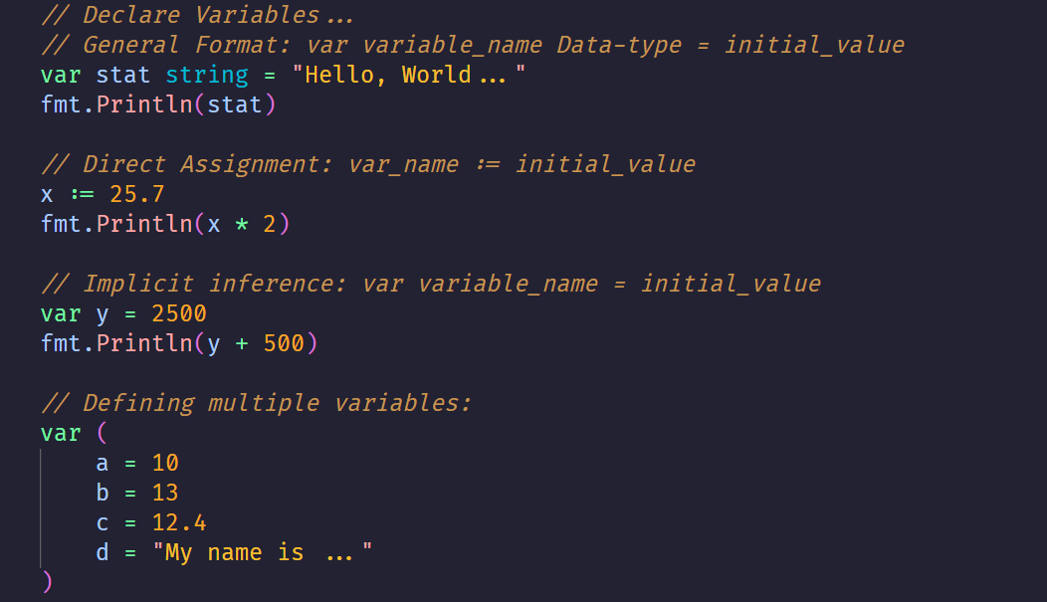
The Go Data Types:
Data types categorize a set of related values, describe the operations that can be done on them, and define the way they are stored.

Slide 9
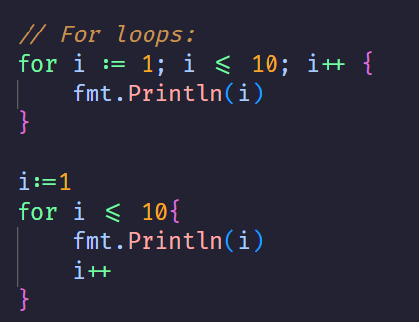
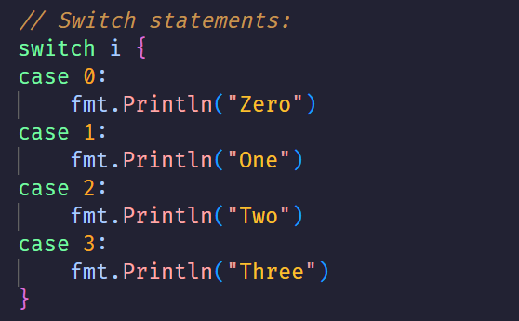
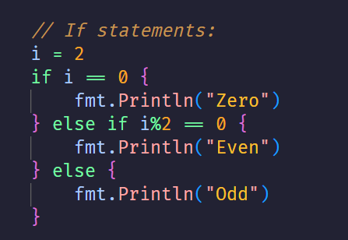
The Go Control Structures:

Slide 10
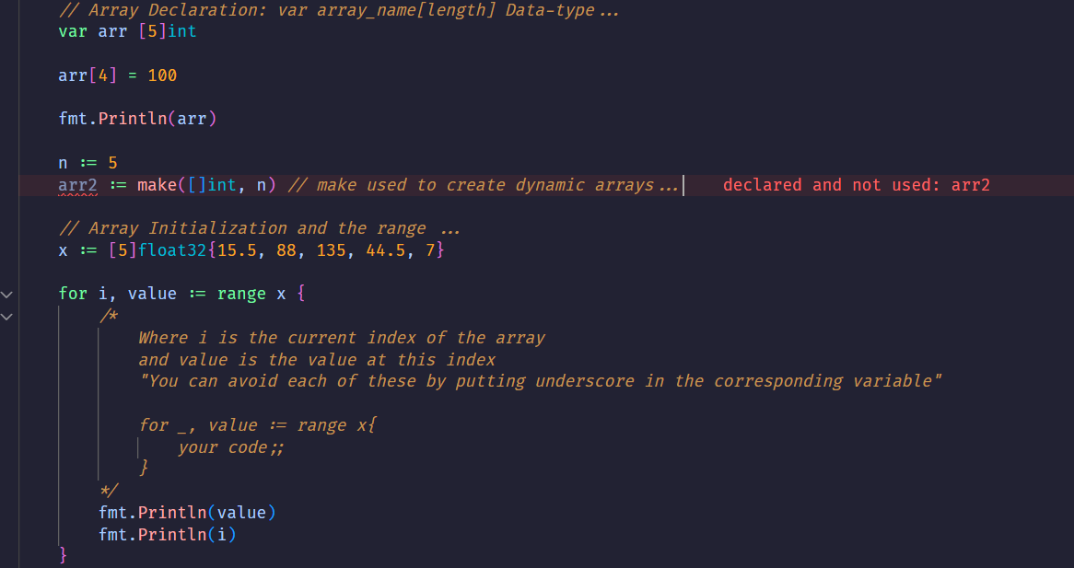
The Go Arrays:

Slide 11
Exercises:
Problem: Implement an in‑place array rotation by k positions to the right (e.g., [1,2,3,4,5] rotated by 2 becomes [4,5,1,2,3]). Handle k > len(arr) and k < 0.
Input: Array of 10 integers, k from stdin.
Output: Rotated array, space‑separated.
Example:
Input: 1 2 3 4 5 3 ; k=1
Output: 3 1 2 3 4 5
Find two distinct indices whose values sum to the target. Return indices (smallest first). Assume exactly one solution. Input: Array size, elements, target.
Find the contiguous subarray with the largest sum. Return the max sum and indices (start, end). Input: Array of integers (may be negative).
Output: "Max sum: X from index i to j"

